Slide 1


“Life, Wine and the Joy of Living”

Slide 2
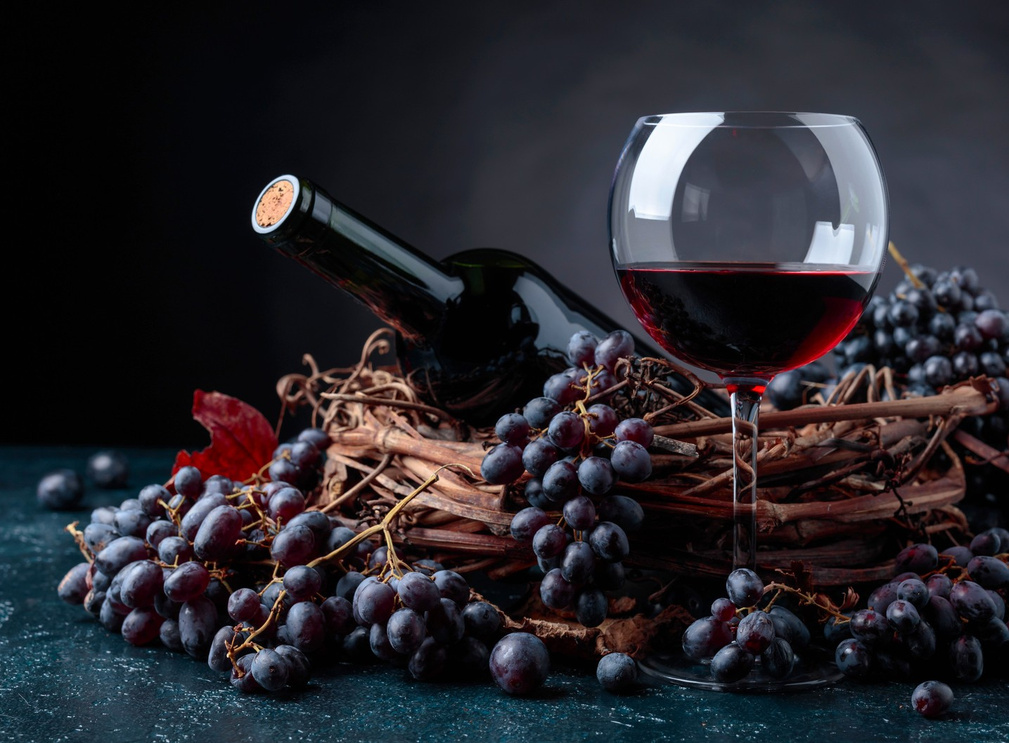

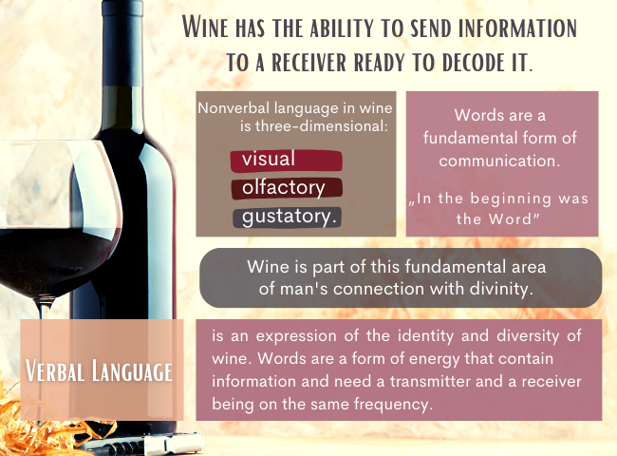


International exhibition organized by
Euro Photo Art International Association
together with the Association for Wine Culture and Civilization Millésime
and the support ofSummit Agro România.

Slide 3
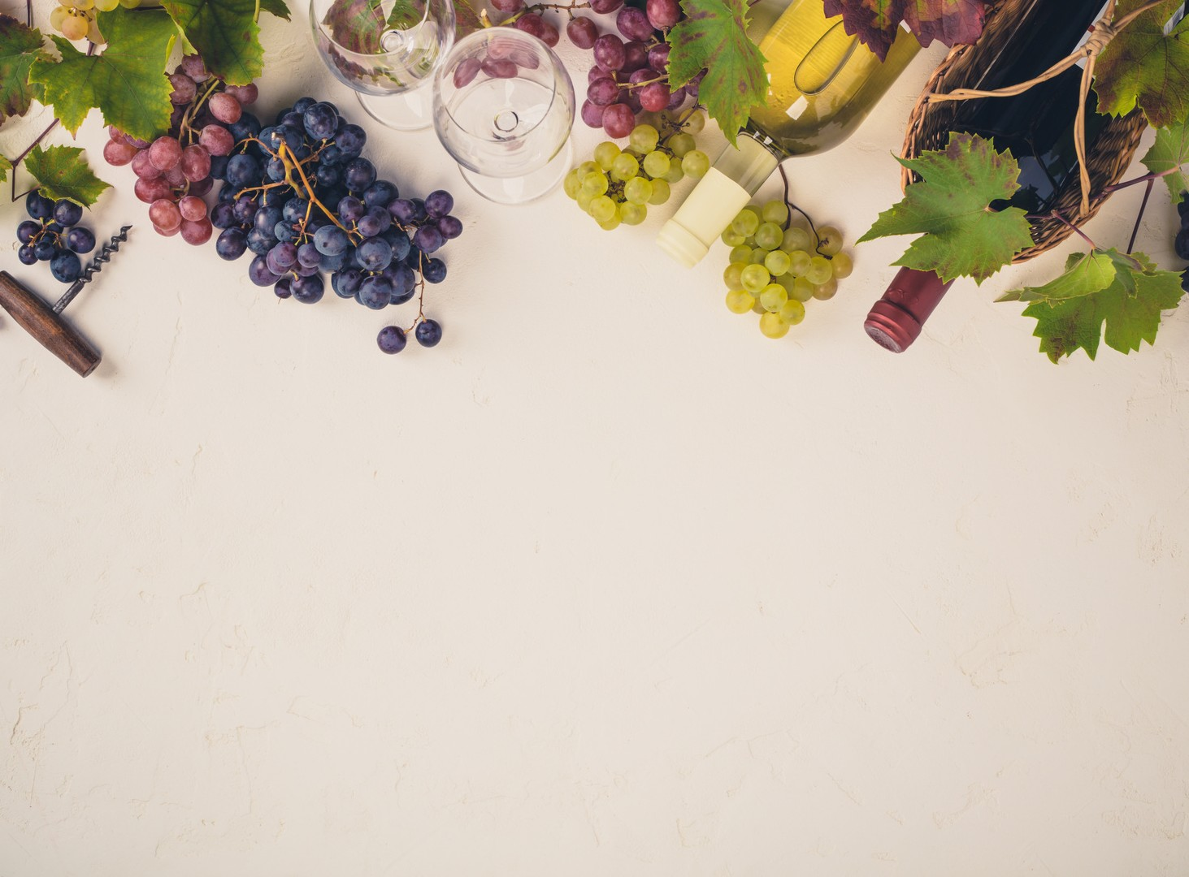
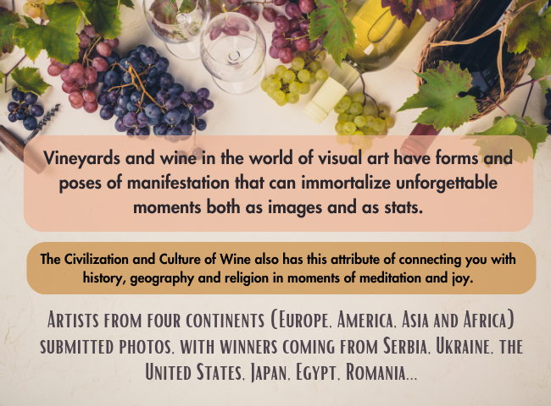
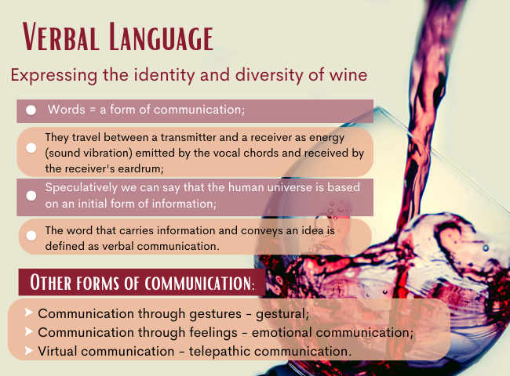
Vineyards and wine in the world of visual art have forms and poses of manifestation that can immortalize unforgettable moments both as images and as stats.
The Civilization and Culture of Wine also has this attribute of connecting you with history, geography and religion in moments of meditation and joy.
Artists from four coNtiNeNts (Europe, America, Asia aNd Africa) suBmitted photos, with wiNNers comiNg from SerBia, UkraiNe, the UNited States, JapaN, Egypt, RomaNia...

Slide 4
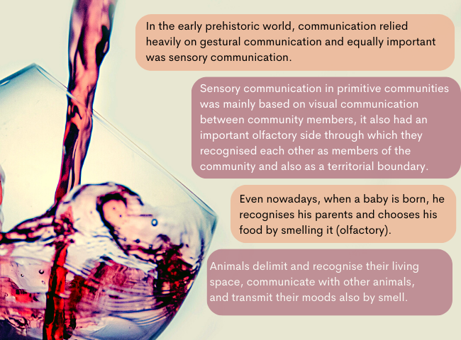

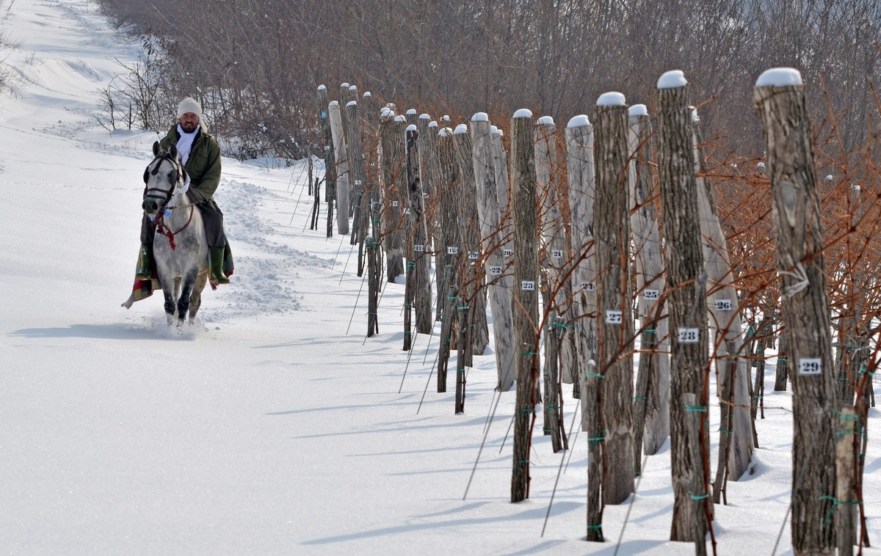
Ótos András

Slide 5
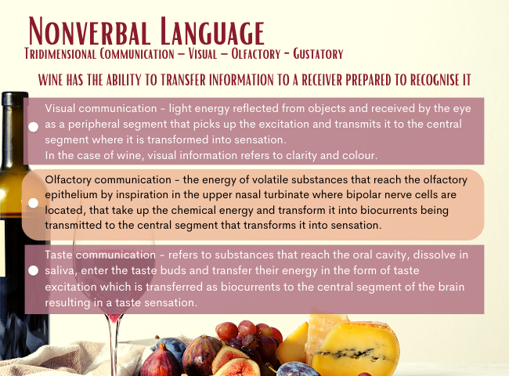
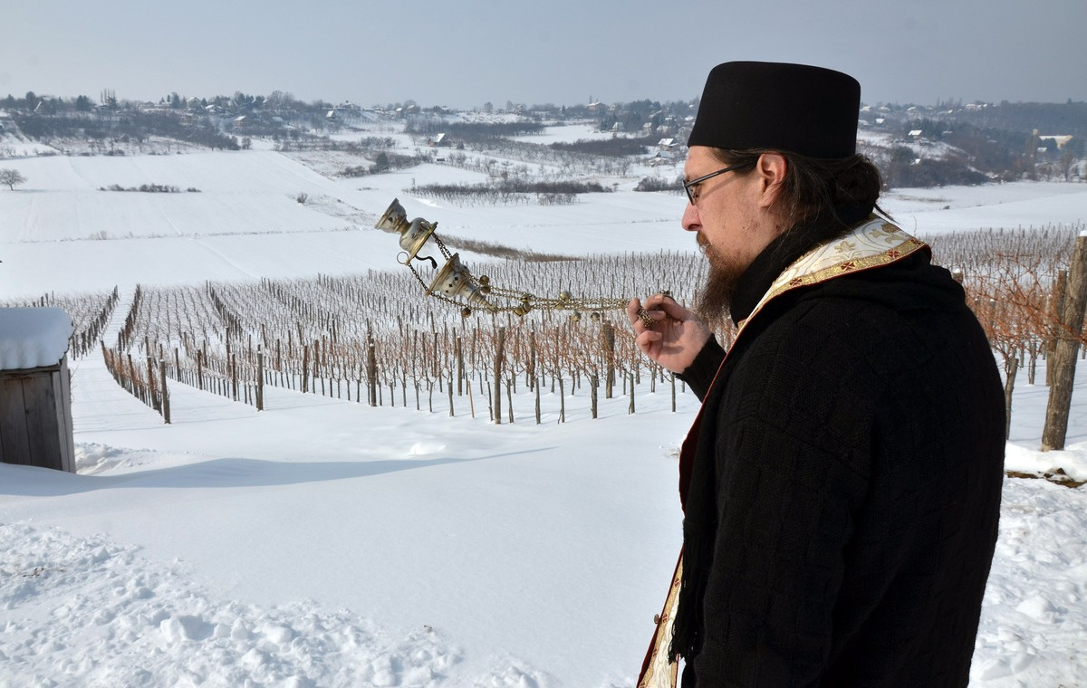
Ótos András

Slide 6
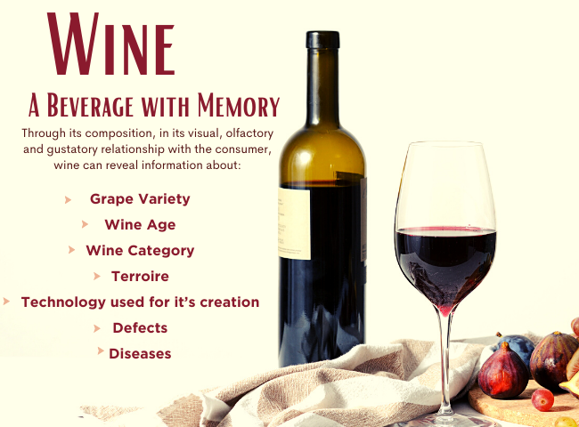
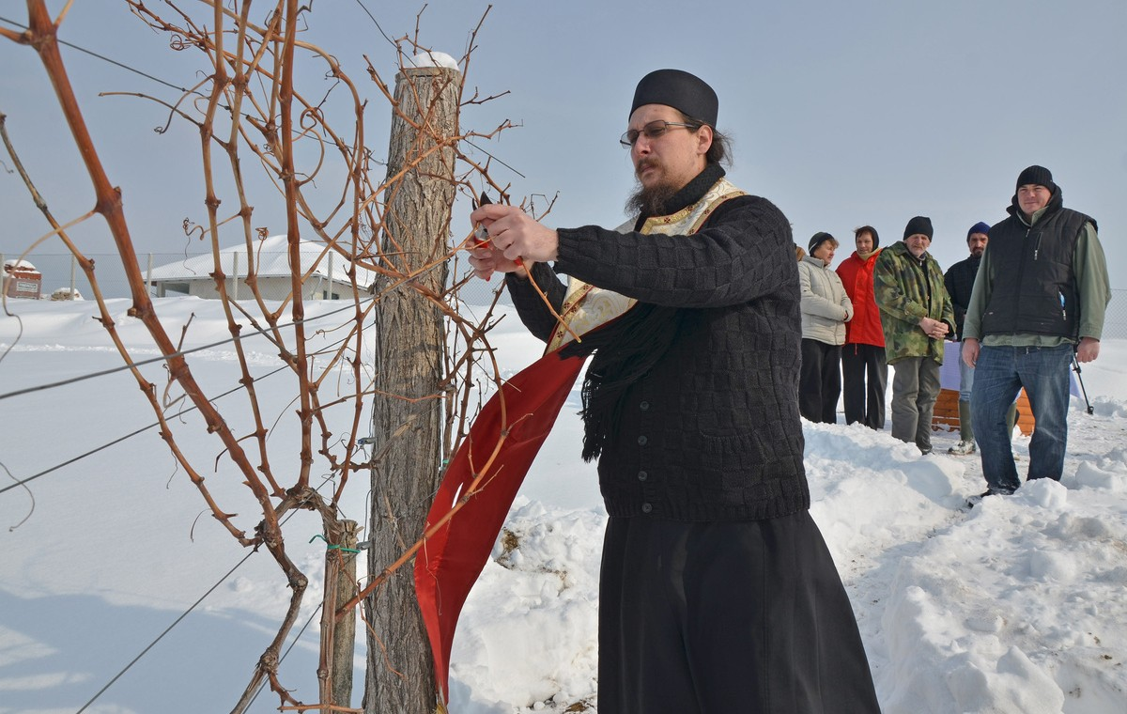
Ótos András

Slide 7
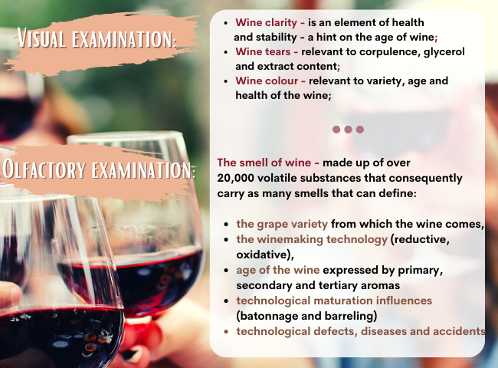
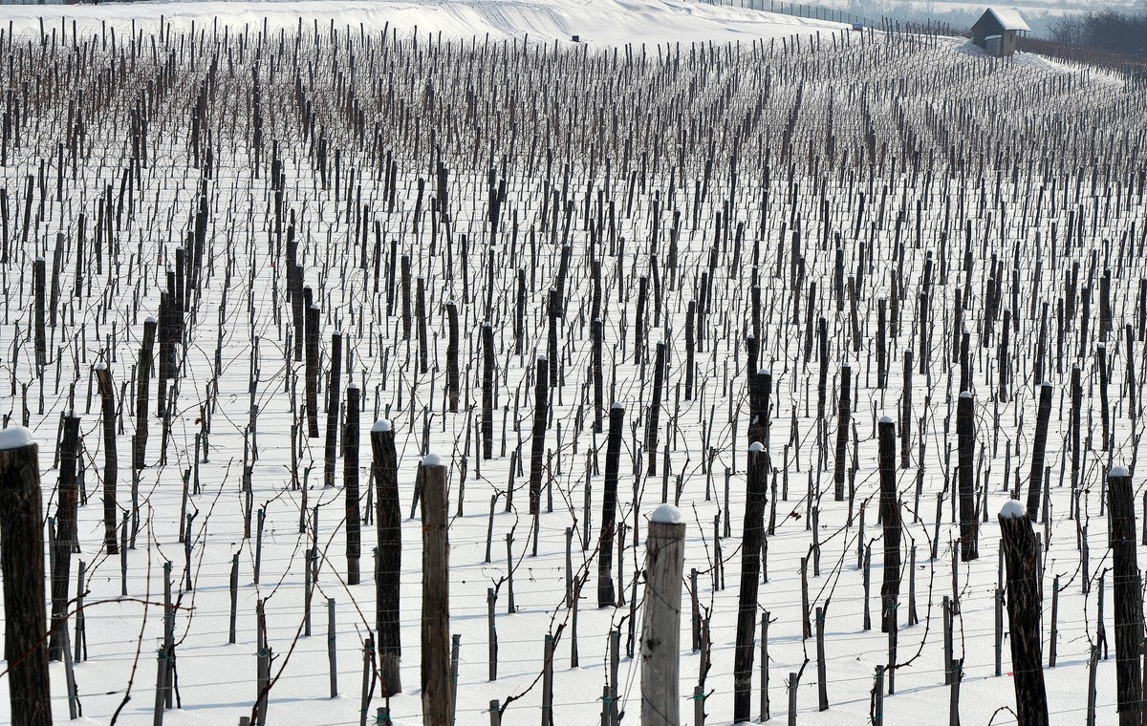
Ótos András

Slide 8
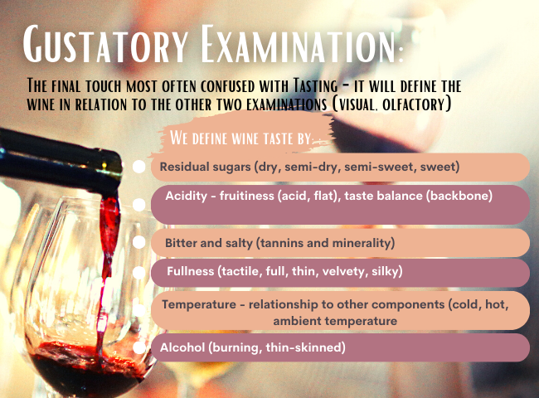
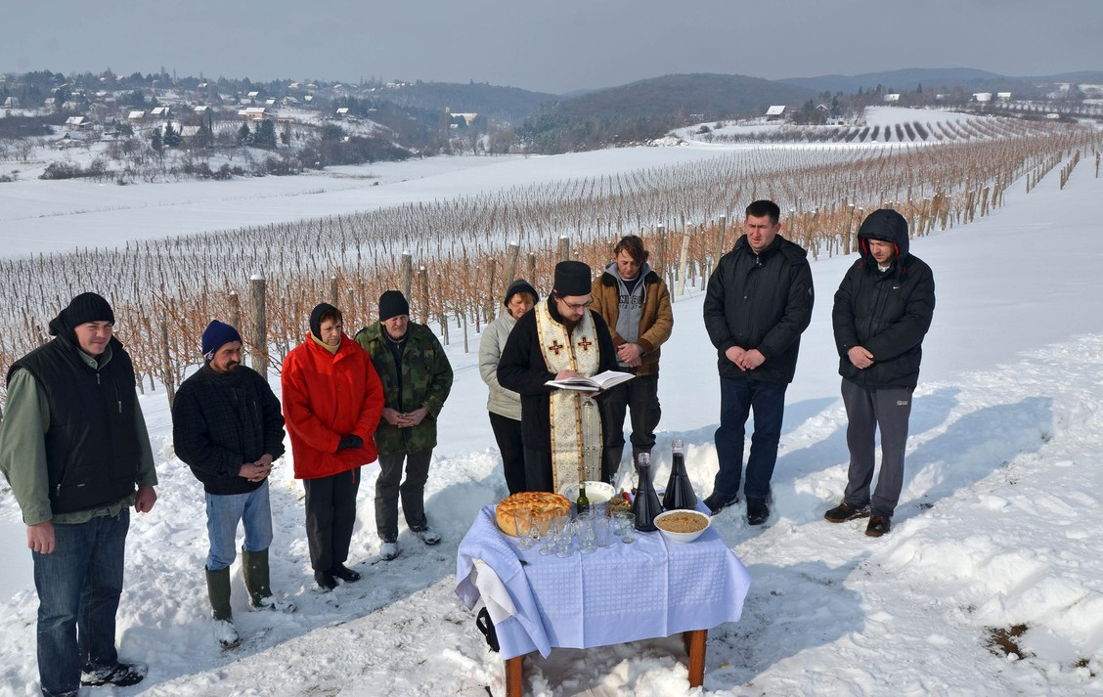
Ótos András

Slide 9
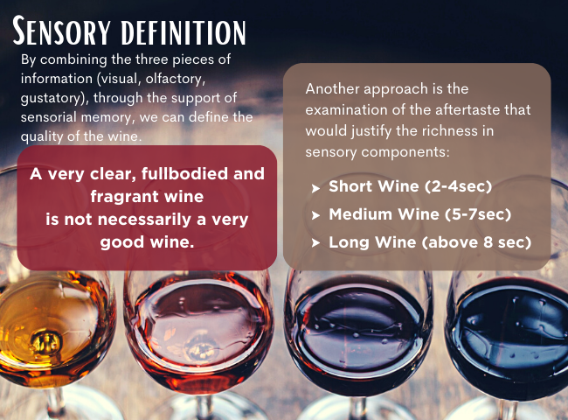
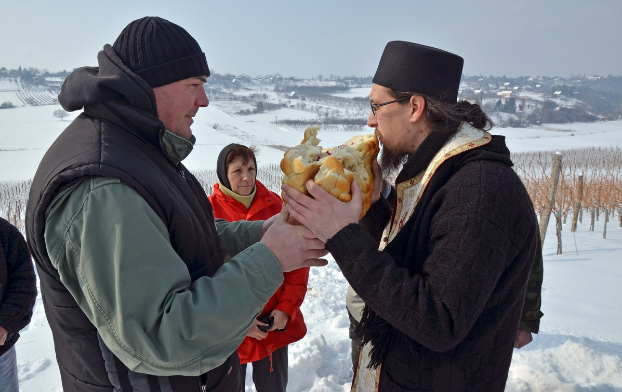
Ótos András

Slide 10
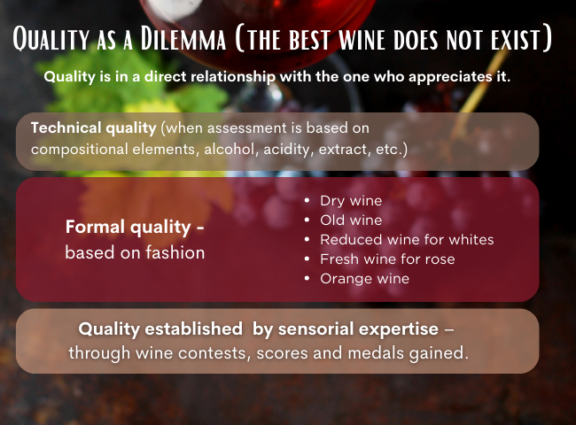
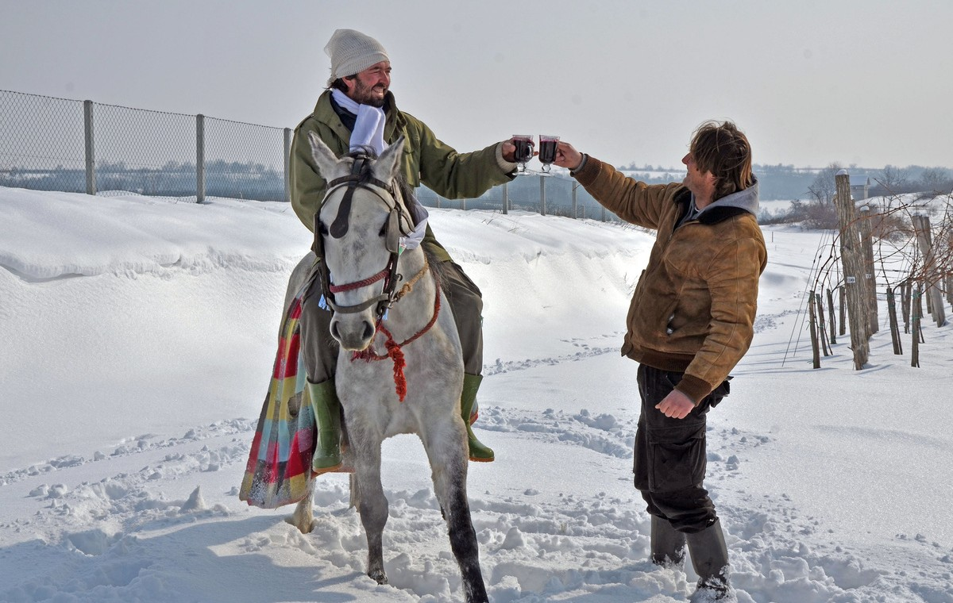
Ótos András

Slide 11

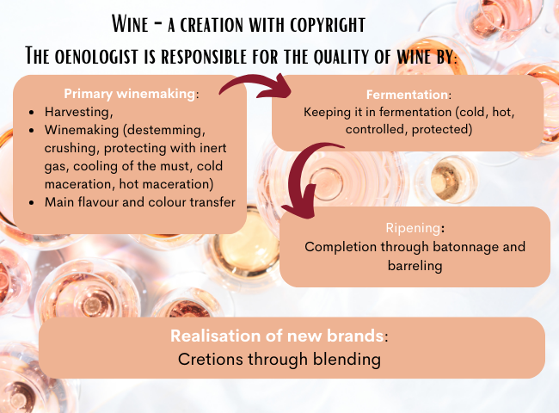

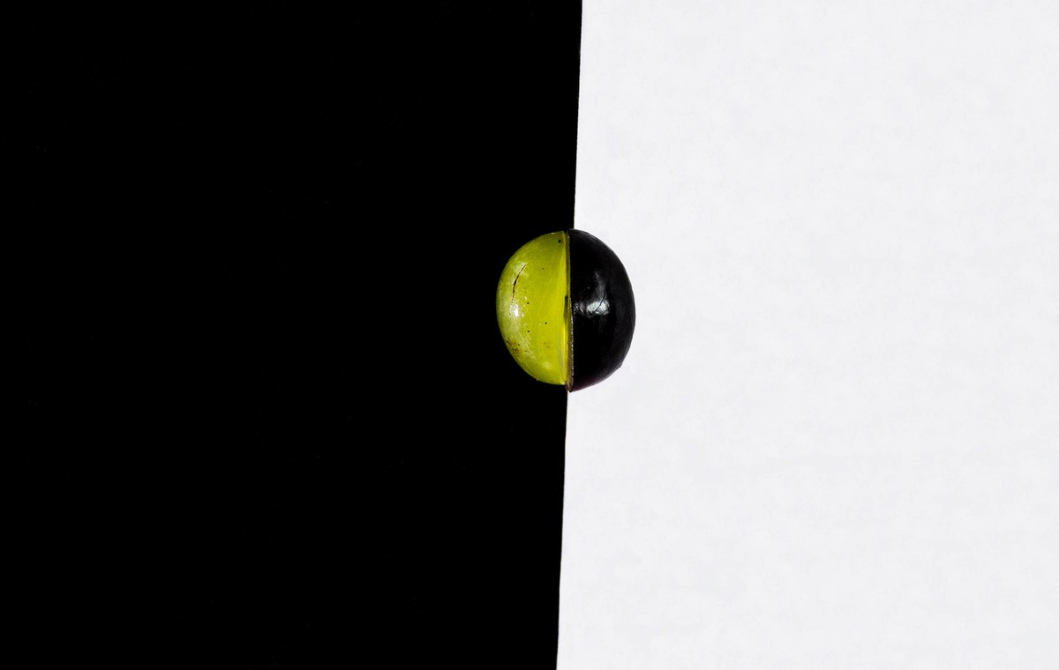
Hős Norbert
Yin-Yang Grapes

Slide 12
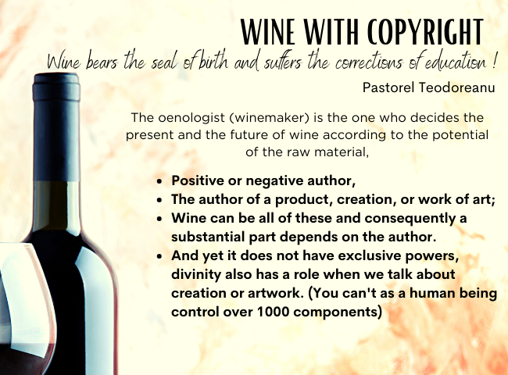
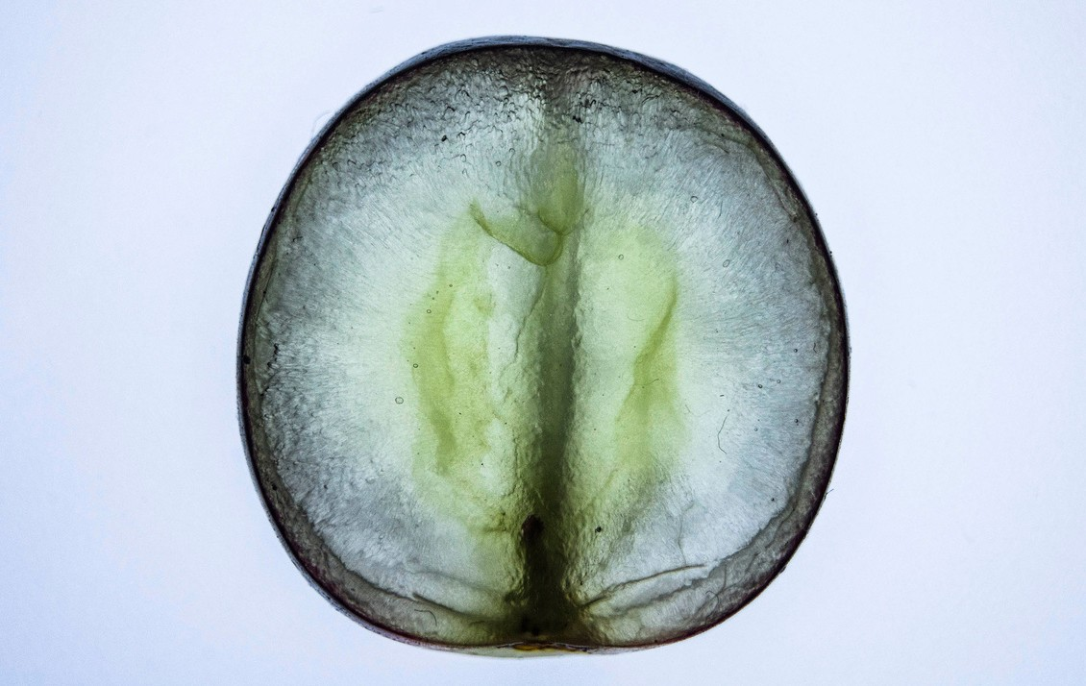
Hős Norbert
Grape-stract

Slide 13

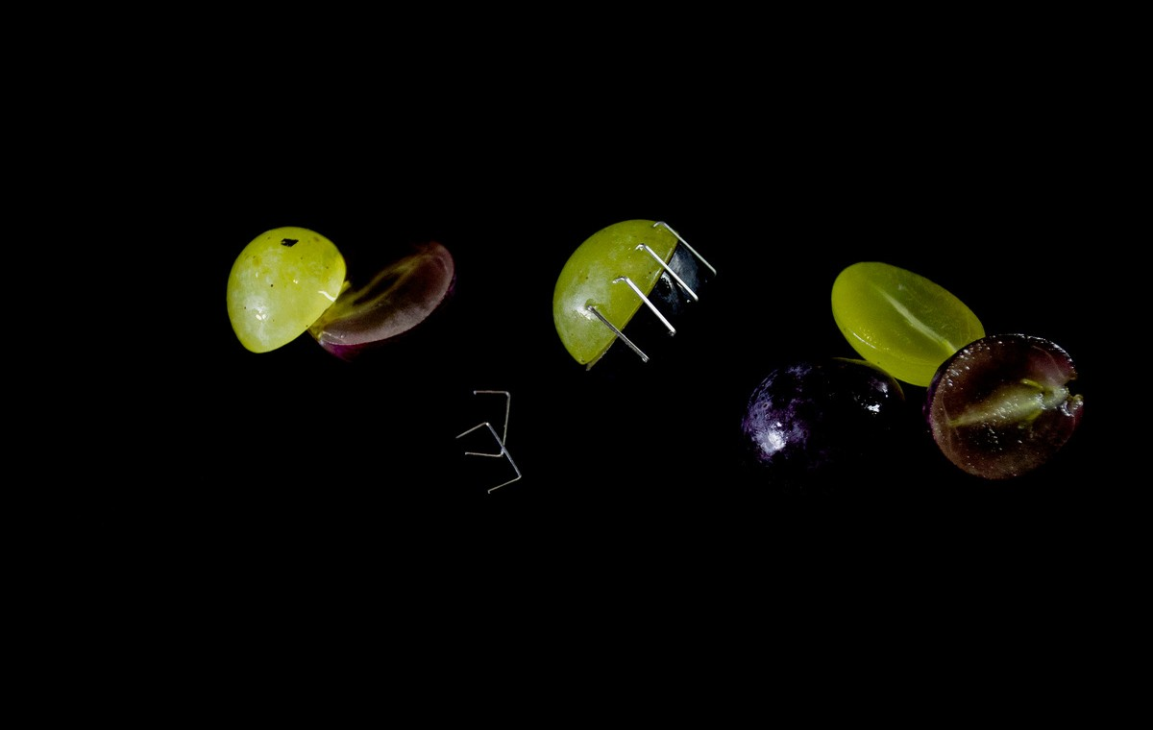
Hős Norbert
Healed

Slide 14
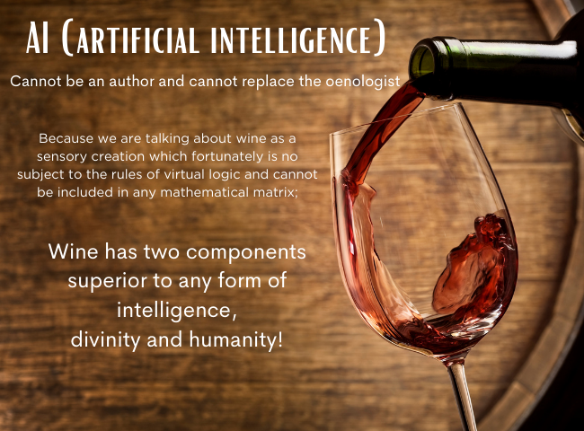
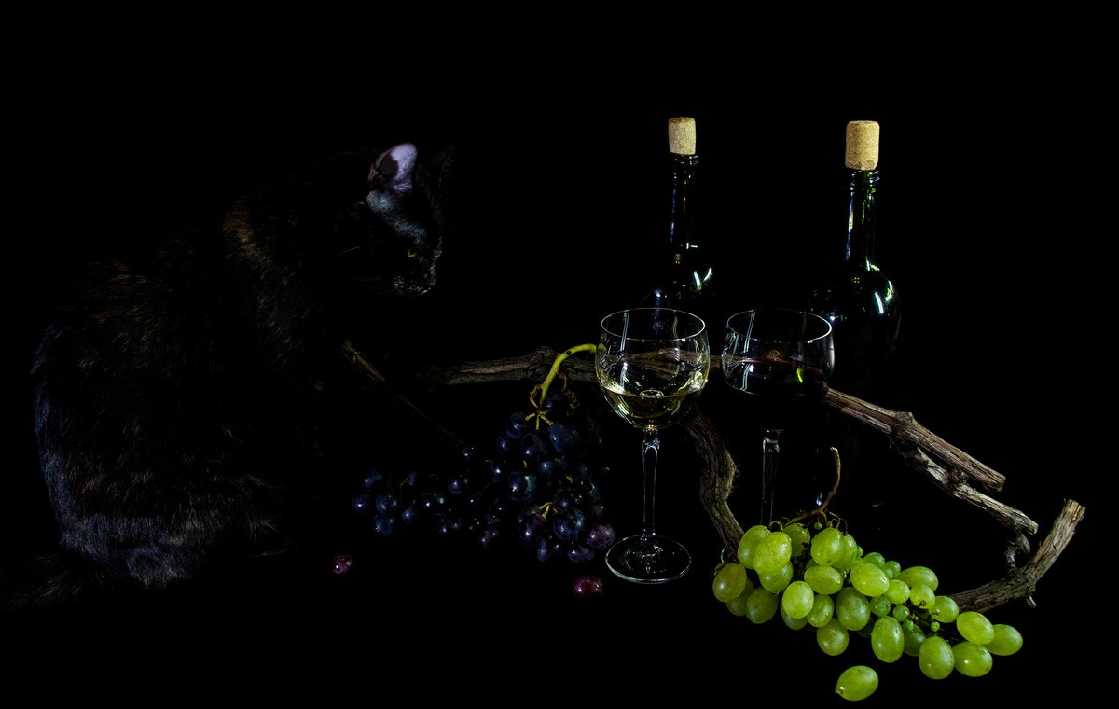
Hős Norbert
Wine Gazing

Slide 15

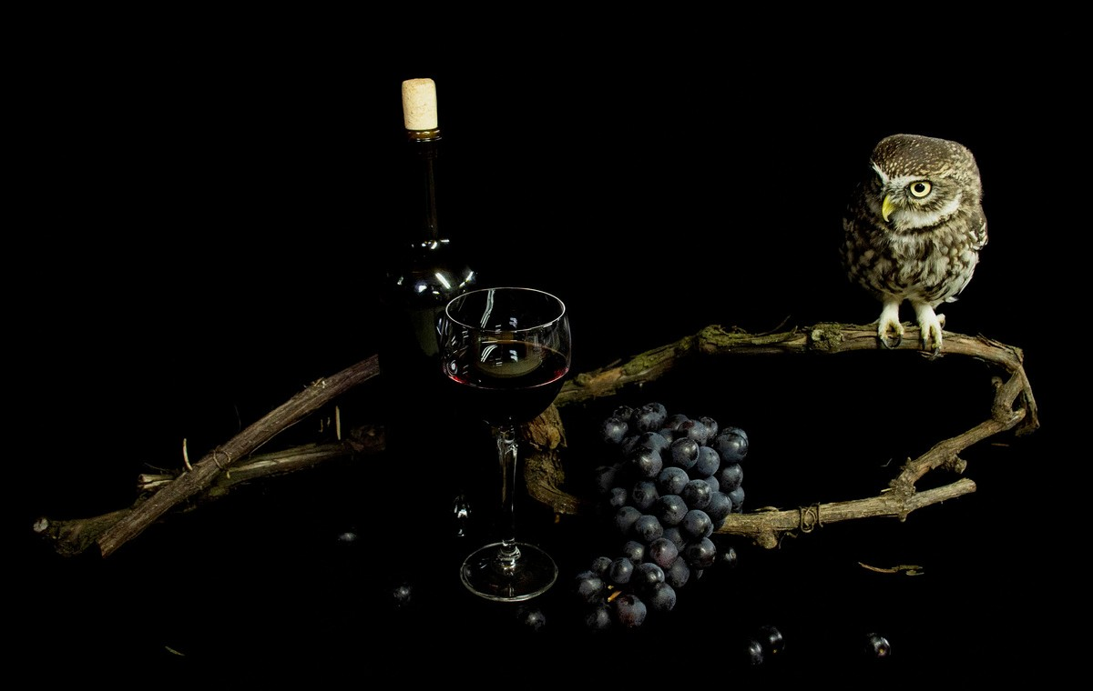
Hős Norbert
Owl

